Slide 1
Kemptville District Soccer Club Online Registration

Slide 2
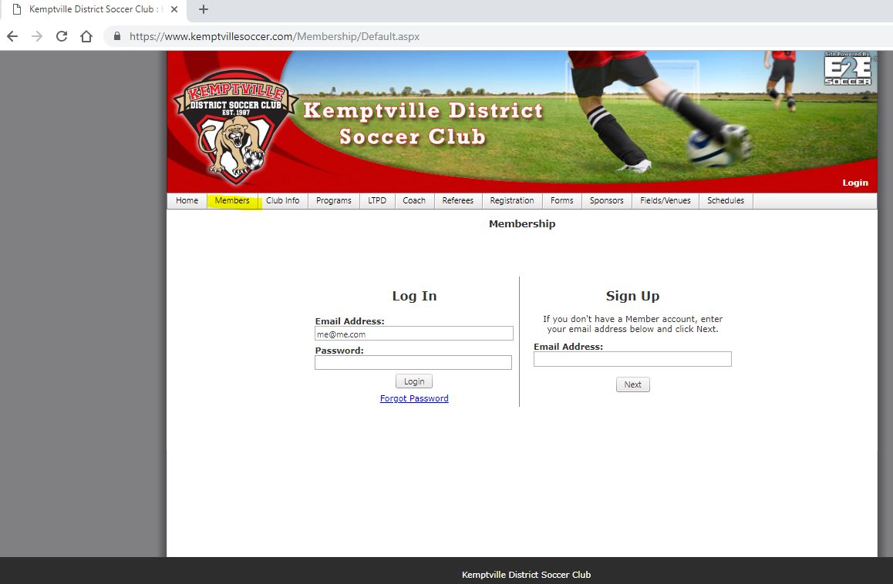
Welcome to Our Online Registration System Step 1: Sign Up
Step 1
This is a new registration system as of 2017. If you have an account you can log in using the Login on the upper right. If you are having trouble logging in please contact club@kemptvillesoccer.com
If you do not have an account select the Members tab and select Login from the dropdown menu.
Enter your email address in the Sign Up section.

Slide 3
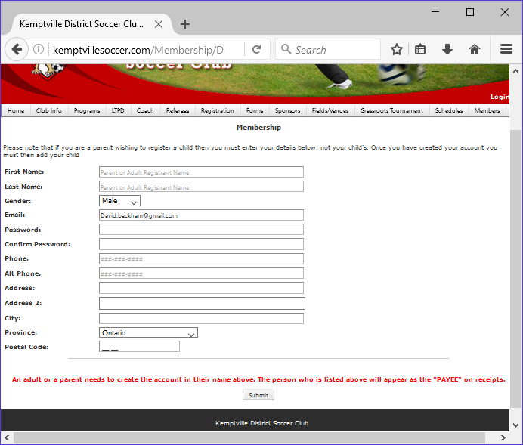
Step2: Creating Parent’s/Guardian’s Profile
Step 2
Parents/Guardians will be required to enter their details first.
DO NOT ENTER YOUR CHILD’S INFORMATION HERE.
Enter all your information as required.
Click submit.

Slide 4
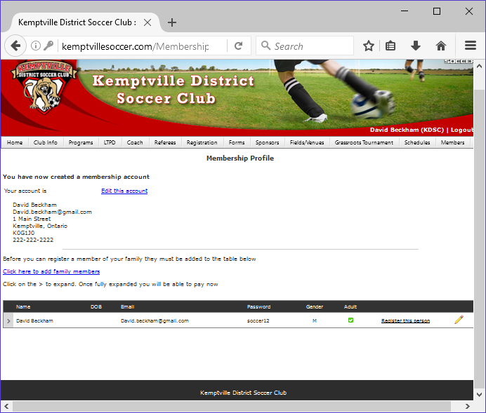
Step 3: Creating A Player Profile
Step 3
You can now create a player profile.
Click the blue link “Click here to add family members”

Slide 5
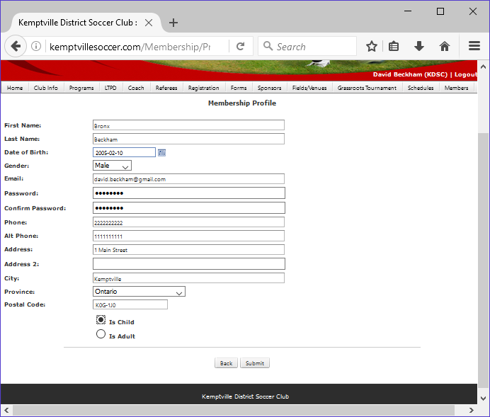
Step 3 Con’t: Creating Your Family’s Profile
Fill in your family’s personal information.
We recommend using the parent’s email address for all child players as all communications from the Club will be sent to this email. Child and youth players do not require a password.
If entering another parent or guardian, ensure you check off that they are an adult
If entering your child’s information, ensure “child” is selected
Click Submit

Slide 6
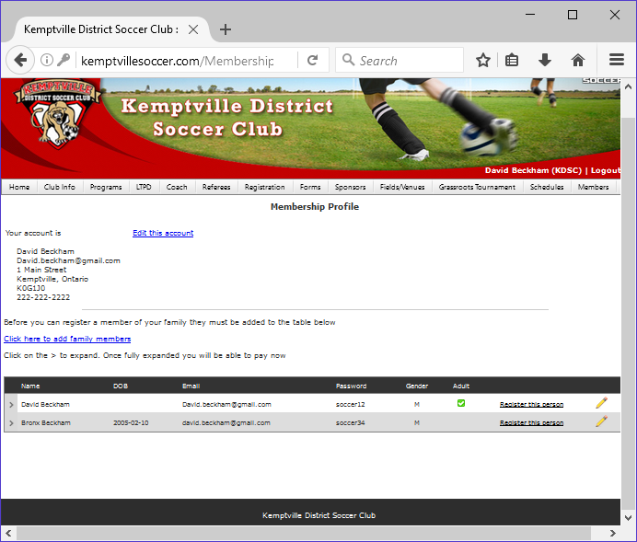
Step 3 Con’t: Creating Your Family’s Profile
Adults on your profile are listed with the
You can edit a person’s profile by click on the

Slide 7
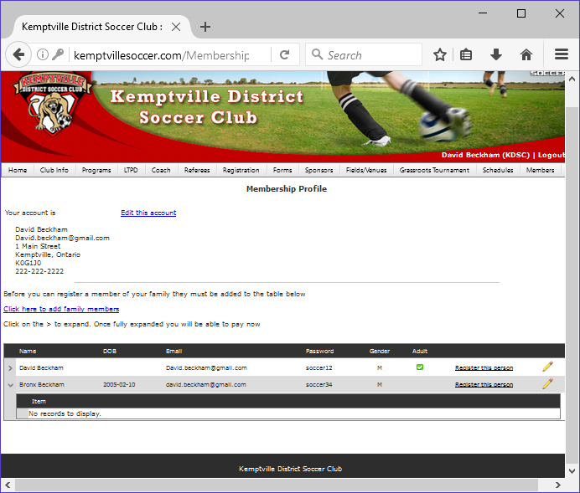
Step 4: Registering for a Program
Step 4
To view which programs a player has been registered to, click on the >
To register for a program, click on “Register this person”

Slide 8
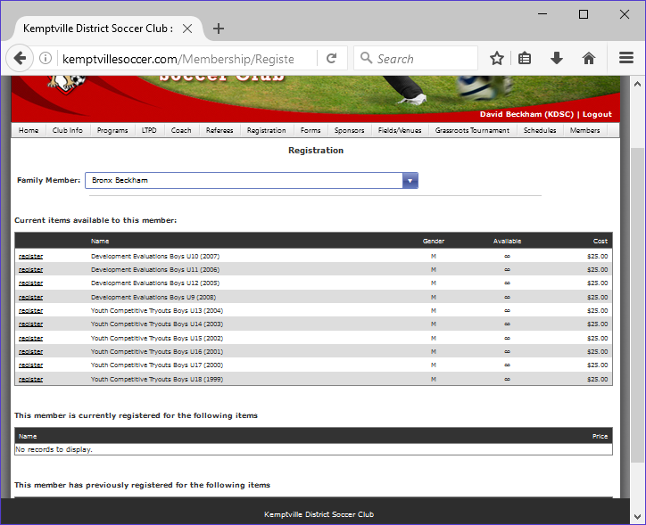
Registering for a Program
Select the program you want to register for.

Slide 9
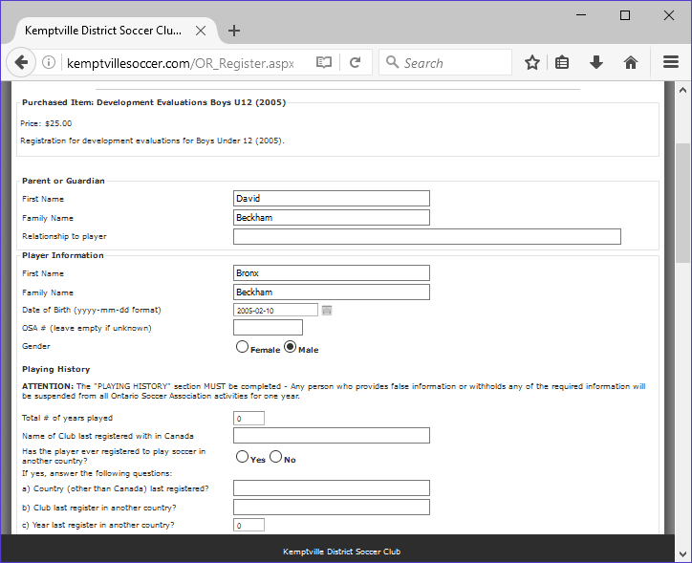
Registering for a Program
Fill out all required information and check off waivers.
Click Purchase Another or Proceed to Cart at the bottom of the form.

Slide 10
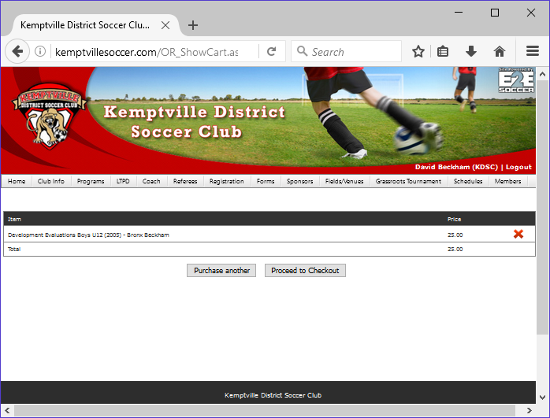
Step 5: Paying for a Registration
A summary of your programs will be listed.
You can cancel a program PRIOR to purchasing by click the
Step 5
To pay for your program, click “Proceed to Checkout” to pay by PayPal or credit card, or “Submit and Pay Offline” and either mail a cheque or come into the office to pay by cash or cheque. The photo does not show the “Submit and Pay Offline” option.
PayPal will open in a new window if you select “Proceed to Checkout.” You can pay using PayPal or your credit card

Slide 11
For further information or any issues please contact the club at:
club@kemptvillesoccer.com

